Slide 1
BOB- MICROSOFT AUTOMATED CHEQUE PROCESSING
Sourabh Kumar Janghel

Slide 2
ChequeMate AI vs. TAT The Story
Please Find the Link of the demo here.

Slide 3
HELLO!
I am Sourabh Kumar Janghel
This Presentation contains detailed representation of the POC submitted at Techgig for BOB Hackathon .
You can find me at sourabh.kumar.janghel@outlook.com

Slide 4
The Past! The Present! The Future!
Physical flow of cheques from one bank to another.
Very Large TAT,
Manual Efforts ~ 100%
Added Costs increase
Electronic flow of cheques images from one bank to another with MICR using Cheque Truncation.
Reduced TAT,
Manual Efforts ~ 50%
Decrease in Cost
AI age where data is extracted automatically from cheques images with verification of signature and account details with bank handshakes.
TAT in hours rather than days,
Manual Efforts ~ 20%
Minimal Cost

Slide 5
Description Of Solution
1
Description of what the Team has tried to build

Slide 6
THE BIG IMPACT.
WEB UPLOAD
A web app to upload your cheques – Enriched User Experience
OPTMIZATION
Whitespace and DPI optimization before uploading and processing cheque – Bandwidth saving
EXTRACTION
Extract the Cheque Entitles and create a structure response - Extraction of Information
TRANSLATION
Detecting Language and converting the text to English. Translation to ENG
MASKING
Masking the sensitive information in the cheque after process completion –Masking entities
DB
Upload the generated results to azure DB and integrate to downstream applications - Storing

Slide 7
PROCESS
Upload document to website
Categorize extracted data into entities- structured and unstructured data
Verify signature using the signatures stored with cosine similarity using pre-trained VGG16 model
Mask Data for identified fields
Optimize image for white space and DPI with Quality preserved
Upload to azure blob storage
1
2
3
4
5
6
7
8
9
10
11
12
cheque Cleaning and
De-noising
Identify document type (PDF/Image)
Extract data from Azure form recognizer either using the custom trained ones or a general one
Detect signature using azure data extracted with a YOLO v5 custom trained model
Translate text to English if require by auto-detecting language
Upload the JSON data created to Azure cosmos DB

Slide 8
Architecture
2
High-level implementation / Solution diagram

Slide 9
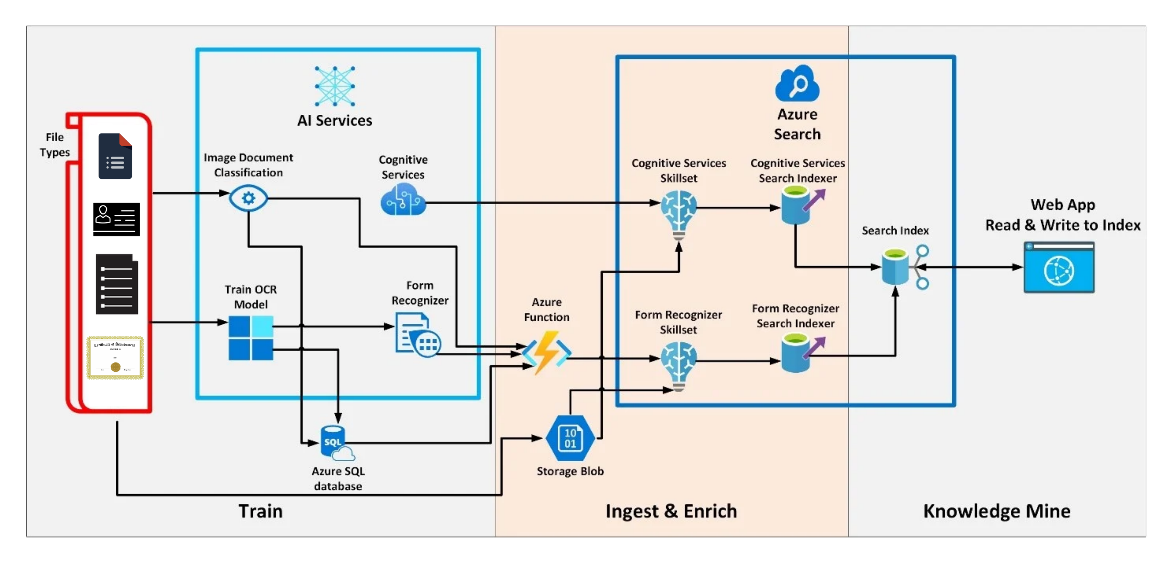

Slide 10

A PICTURE IS WORTH A THOUSAND WORDS
A complex idea can be conveyed with just a single still image.
Namely making it possible to absorb large amounts of data quickly.

Slide 11
Output
5
Test cases and corresponding processed output file(s) along with the output time

Slide 12
Demo -Translation
Please Find the Link of the demo here.

Slide 13
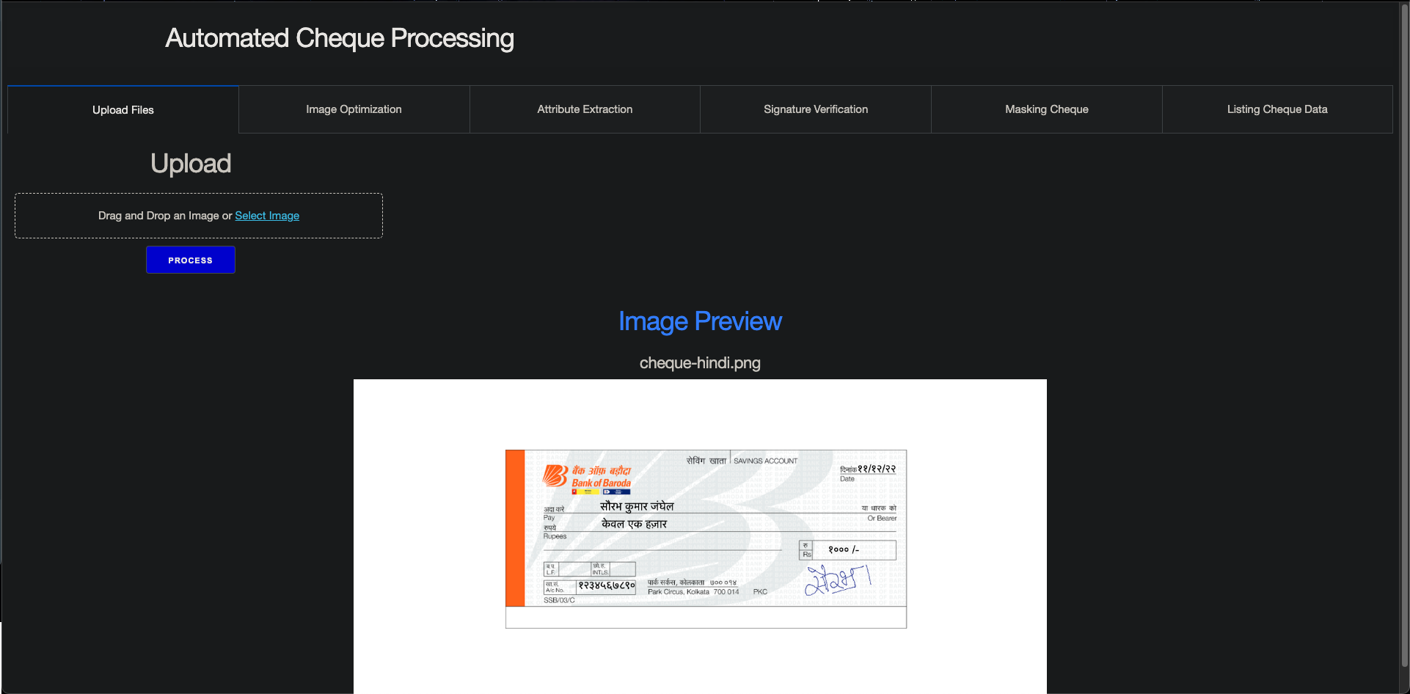
Upload

Slide 14
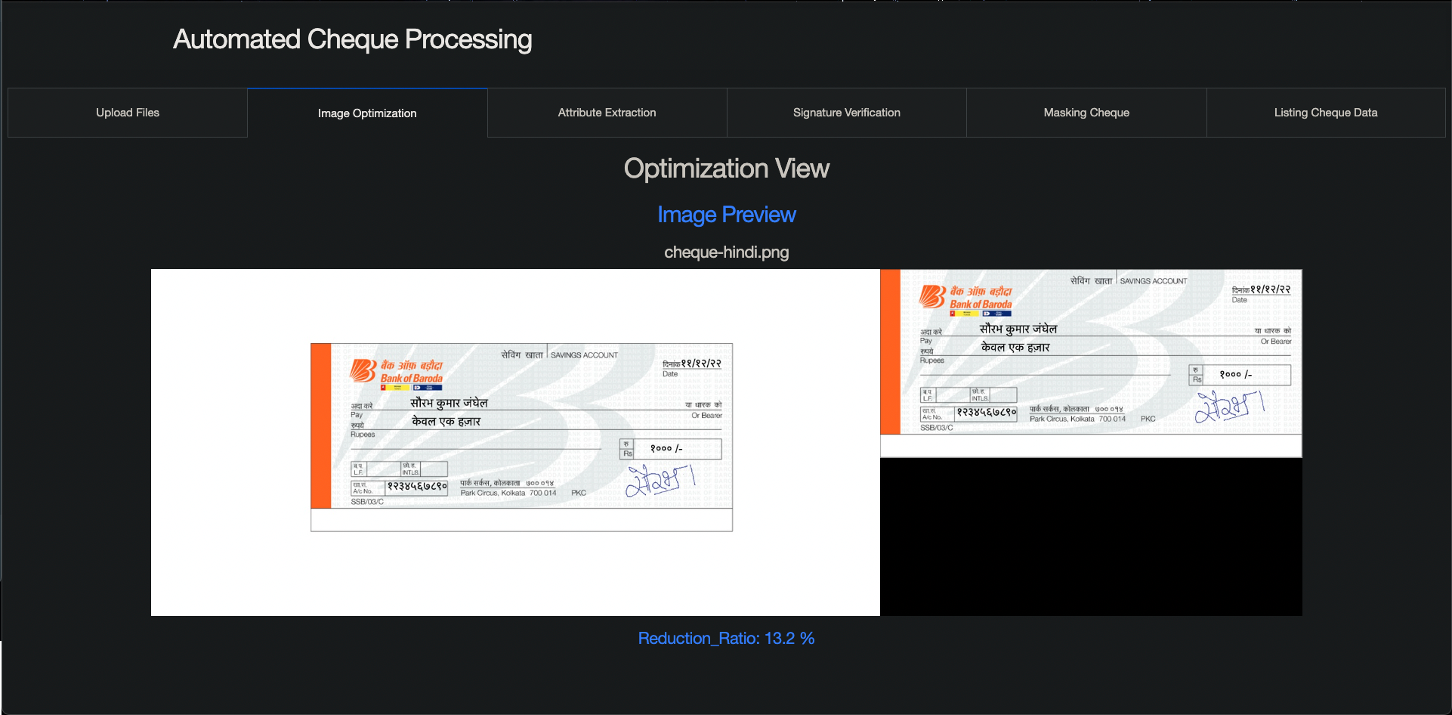
Optimization

Slide 15
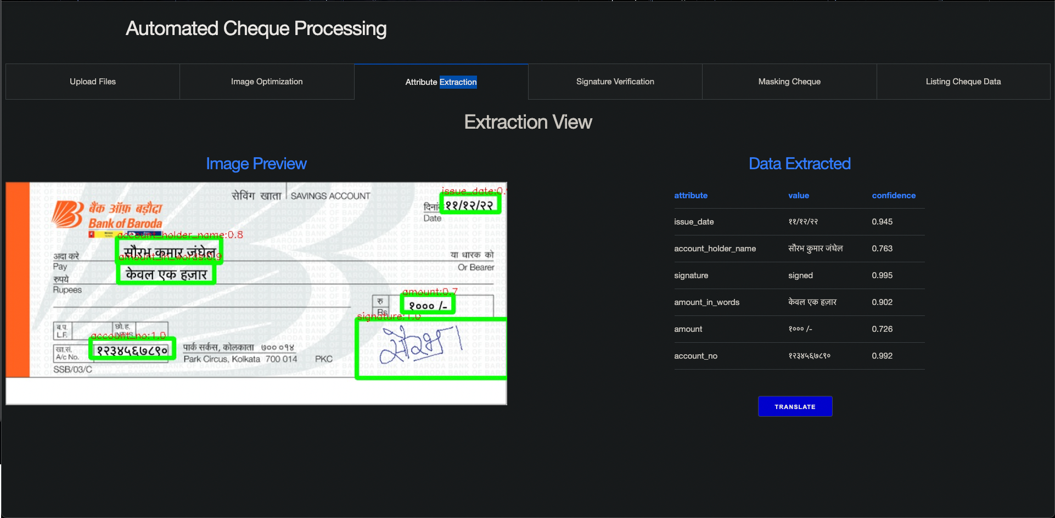
Extraction

Slide 16

Translation

Slide 17
Demo - Signature
Please Find the Link of the demo here.

Slide 18
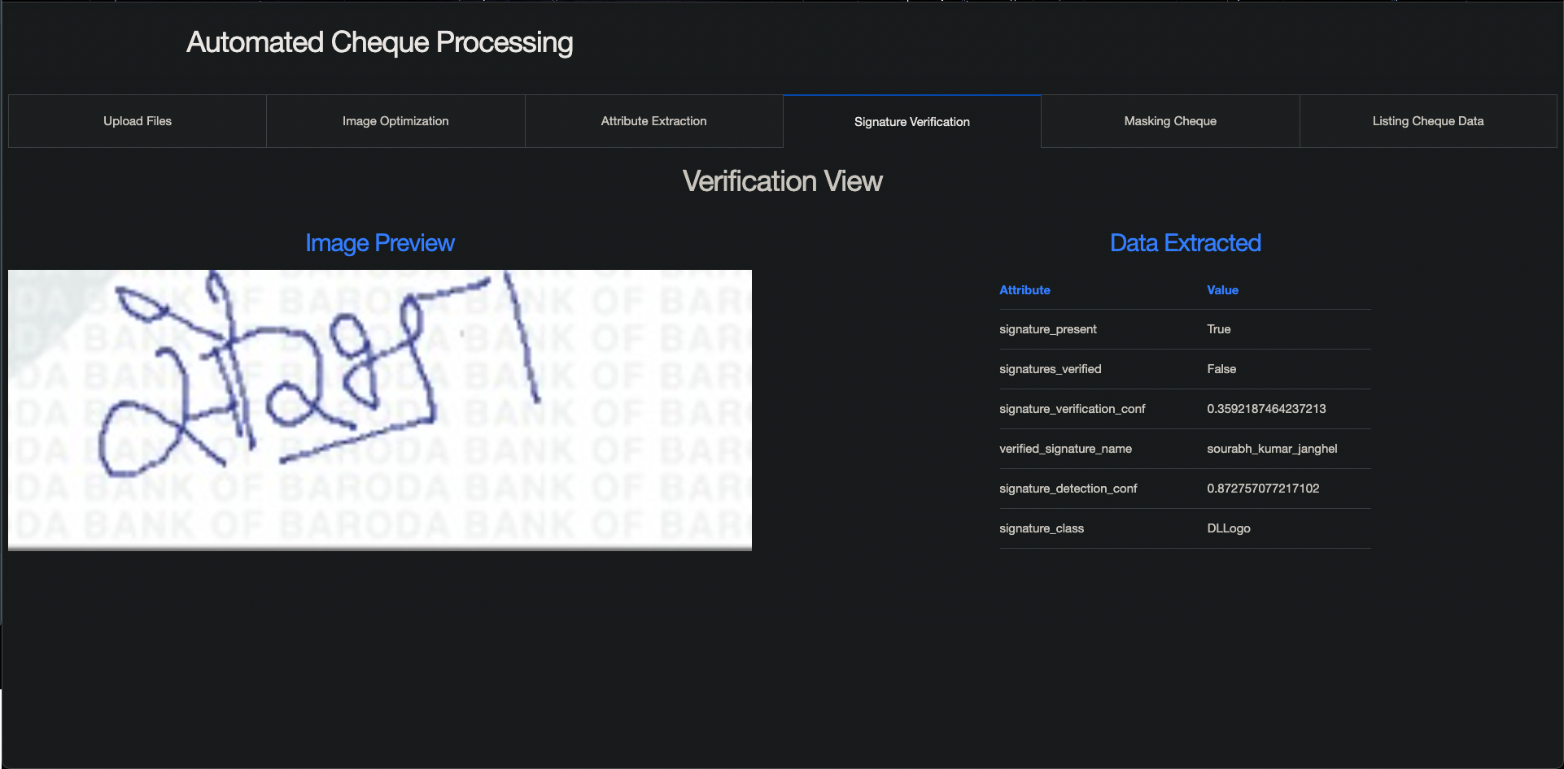
Signature

Slide 19
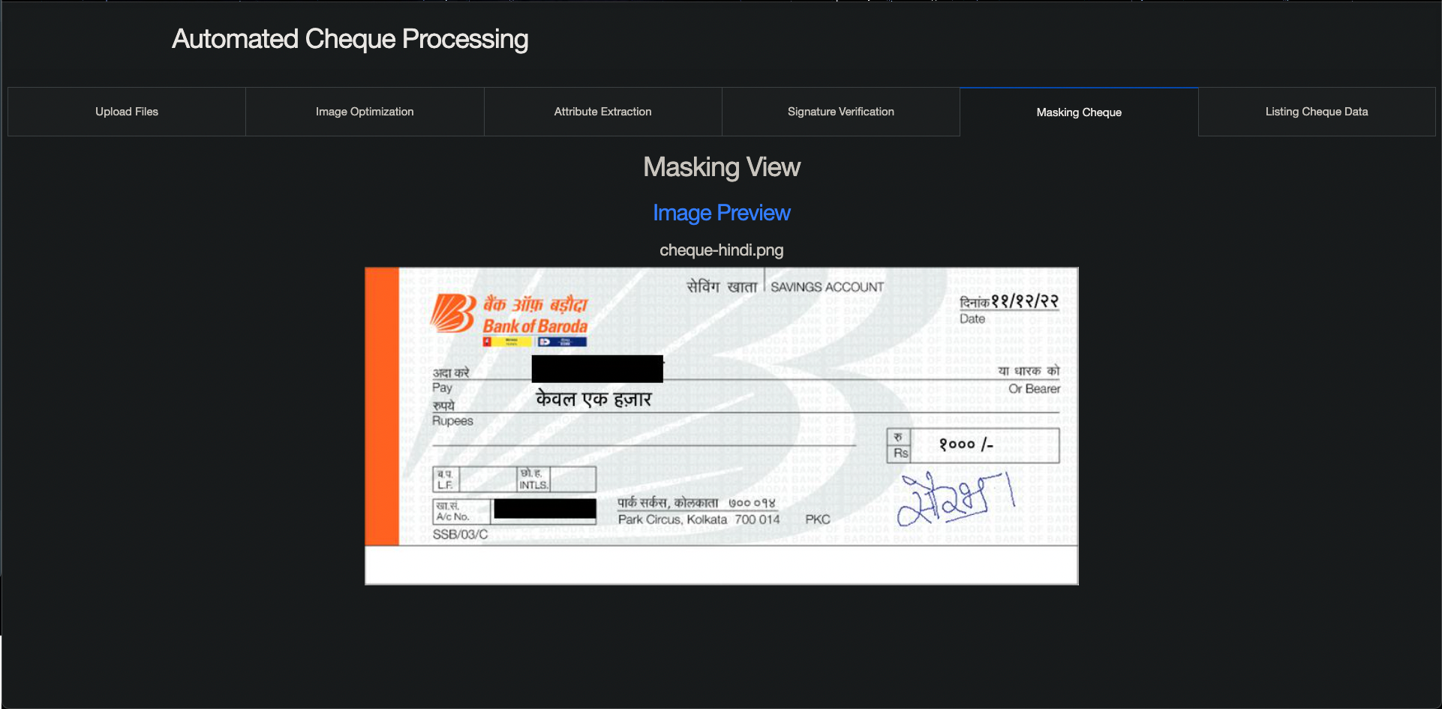
Masking

Slide 20
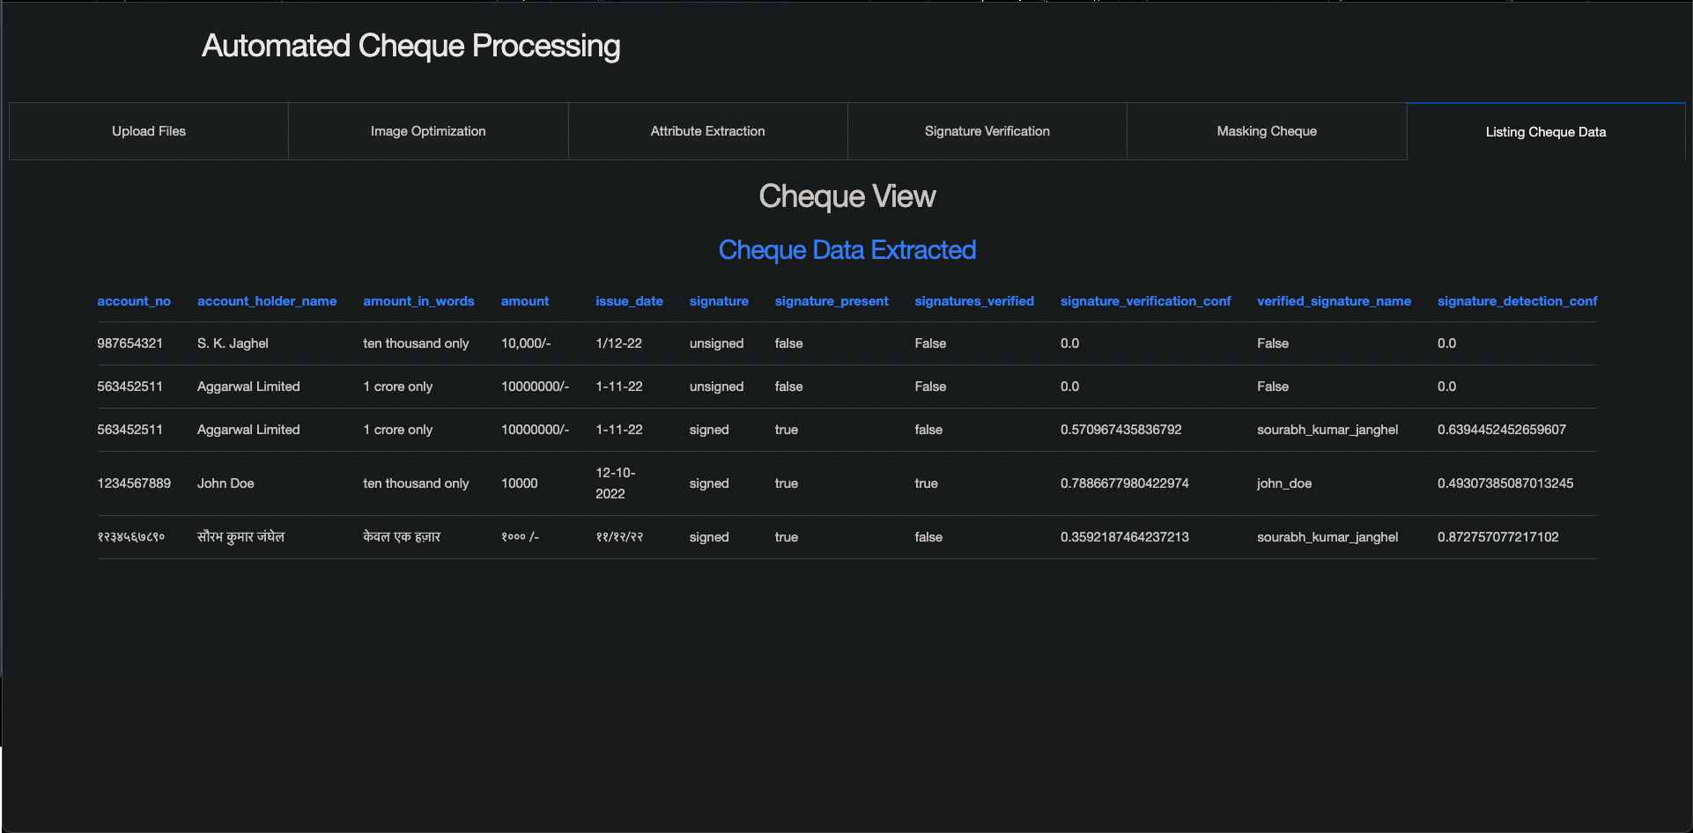
DATA VIEW

Slide 21
Summary
6
A write-up on why your application /solution should be considered

Slide 22
Why the solution should be considered?
The below points can be considered for my submission:
A UI added to make the process of processing cheque easier which can be integrated with downstream systems.[Ease of Use]
Works well for Both Handwritten and Printed Images which contains noise.[Robust]
Custom Processor Models to extract structured and unstructured text from the cheque(Azure Computer Vision OCR) without large datasets with good confidence.[Accurate]
Signature Identification and Verification using custom model and azure form recognizers with a custom YOLO v5 trained model on signature dataset with VGG vectors along with distance matching to verify signatures.[Offline Models]
Azure Web Apps for hosting and running solution [Auto Scaling]
Azure language translation layer to detect and translate languages.[Multi Language]
Masking of text from cheques to hide sensitive data after processing.[Privacy]
Azure Containers to store documents/images.[High Throughput Storage]

Slide 23
Scaling
7
Ability to scale-up in enterprise grade environment

Slide 24
The Solution Can be dockerised and deployed as a HTTP Azure function or a Web App in azure
AZURE Functions & Containers
100% Scalable
That’s a easy serverless way of running the solution on cloud
instances of the Functions host are dynamically added and removed based on the number of incoming events.
Automatically scales based on demand using pre-warmed workers, which run applications with no delay after being idle, runs on more powerful instances, and connects to virtual networks
Total success!

Slide 25
Deployment
7
Ability to deploy in any environment

Slide 26
The Solution Can be dockerised and deployed in any hosting
Cloud & On-Premise
100% Portable
It can be hosted in both -
If we opt for an on-premise solution or a private cloud we will need to custom create the translation models and entity ex traction models.
For cloud if we shift to any cloud we can plug and play with the cloud offering services.
Total success!

Slide 27
Tech Stack
3
Tools, Technology Stack (including the APIs consumed), and framework details

Slide 28
TECH STACK ANALYSIS
Tools
Python 3.9
APIs
Azure App Service
Azure Form Recognizer
Azure Translator
Azure Containers
Azure Cosmos DB
Storage
Tensorflow
Torch
Framework

Slide 29
Algorithms
4
The algorithms / machine learning models that have been used in the Hackathon prototype

Slide 30
USED Algorithms
ImageHash
pdf2image
signature-detect
Vgg16
Yolo v5
numpy
opencv-python
Pillow
imutils
tqdm
azure-formrecognizer
azure-computervision
azure-translator
azure-storage-blob

Slide 31
Building Efforts
7
How does the prototyping timeline looks like?

Slide 32
GANTT CHART
 | Week 1 |  |  |  |  |  |  | Week 2
 | 1 | 2 | 3 | 4 | 5 | 6 | 7 | 8 | 9 | 10 | 11 | 12 | 13 | 14
Dash UI Task 1
Backend Coding Task 2 |  |  |  |  |  | ◆
Data Storage Task 3
Integration Task 4 |  |  |  |  |  |  |  |  |  |  | ◆
Testing Task 5 |  |  |  |  |  |  |  |  | ◆
Deployment Task 6
Custom model Task 7
Demo Task 8

Slide 33
Hard Questions & Post Hackthon
7
Ability to deploy in any environment

Slide 34
SWOT ANALYSIS
STRENGTHS
The solution consists of all the necessary step required for automation and has a good confidence score
WEAKNESSES
If we have to use the solution without cloud there would be significant dev efforts required and the performance KPIs will change
S
W
The solution can be used to replace the ongoing manual efforts and reduce cost.
OPPORTUNITIES
The cloud dependency for fin-tech solution is what needs to be explored in terms of encryption and security.
THREATS
O
T

Slide 35
THANKS!
Any questions?
You can find me at
Email@sourabh.kumar.janghel@outlook.com
LinkedIn@sourabhkumarjanghel

